Slide 1



Telco Company
Customer
Churn
Lucie Stenger - Ironhack Bootcamp - October 2024

Slide 2

Company
Dataset
Telecom industry
Telephone & Internet services
Customer demographics
Account information
Services subscribed
Customer churn

Slide 3






Borcelle Company
Reducing churn rate
Analysing
Clustering
Predicting
Analysing customers’ profiles, accounts information, and services used.
Identifying common behaviors and profiles to then group customers into segments with similar characteristics.
Identifying
factors impacting the churn rate, and coming up with recommendations to reduce it.

Slide 4



Exploratory Data Analysis (EDA)
Customers are more likely to churn if:
01
They have no dependent and no partner
05
They have fiber optic Internet service
02
They are a senior citizen (older than 65y)
06
Their contract is month-to-month
03
They are recent customers (less than 1 year)
07
They pay via electronic check
04
08
They subscribe to Internet but do not subscribe to Online security, Online backup, Device protection, or Tech support services
They have multiple lines

Slide 5
Hypothesis Testing
Customers who have been using Telco's services for over one year are less likely to churn.
Customers with month-to-month contracts are more likely to churn.
Senior citizens are more likely to churn than non-senior citizens.
Null Hypothesis (H₀): Customers who have been using Telco’s services for over one year are equally likely to churn as those who have been using it for less than or equal to one year.
Alternative Hypothesis(H₁): Customers who have been using Telco’s services for over 1 year are less likely to churn.
Chi-Square Statistic: 708.78
P-Value: 0
We reject the null hypothesis.
Null Hypothesis (H₀): Customers with month-to-month contracts are equally likely to churn as those with other types of contracts.
Alternative Hypothesis (H₁): Customers with month-to-month contracts are more likely to churn.
Chi-Square Statistic: 1153.97
P-Value: 0
We reject the null hypothesis.
Null Hypothesis (H₀): Senior citizens are equally likely to churn as non-senior citizens.
Alternative Hypothesis (H₁): Senior citizens are more likely to churn than non-senior citizen
Z-Statistic: 12.663
P-Value: 0
We reject the null hypothesis.

Slide 6
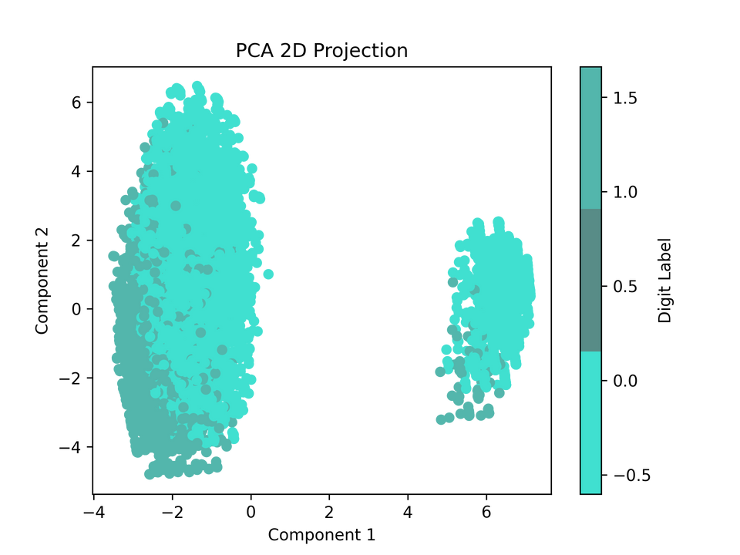

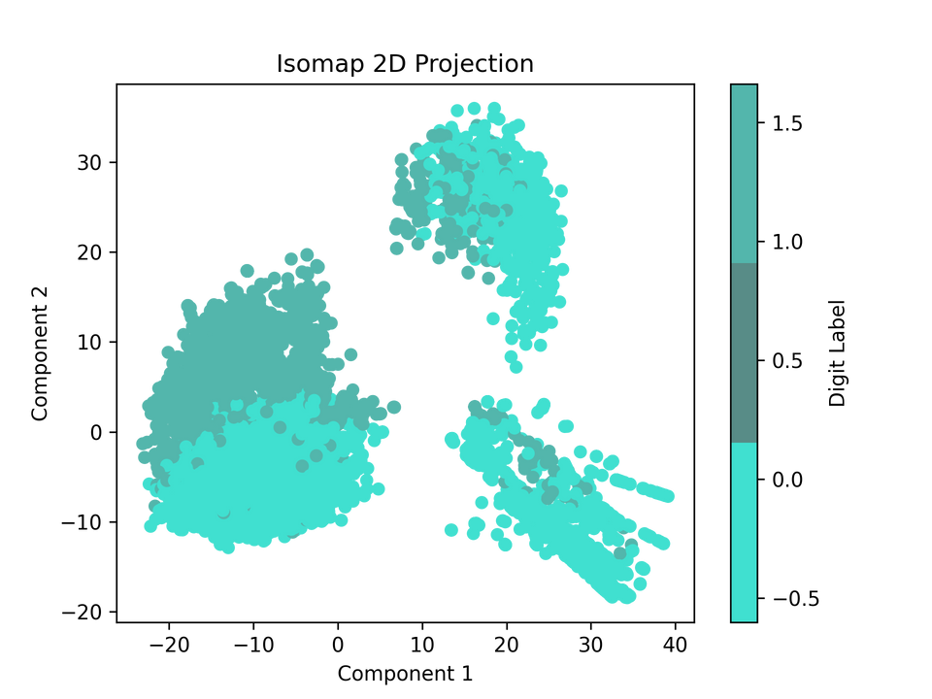
Clustering Algorithms
Step 1:
Transforming categorical features in numerical (dummification).
Step 2:
Standardising the numerical data.
Step 3:
Performing a dimensionality reduction method:
PCA may not be optimal as the first two components explain only 0.38 of the variance, which is less than 80%.
Isomap method seems to be more relevant than PCA for the 2D projection as we discovered a 3rd cluster.

Slide 7
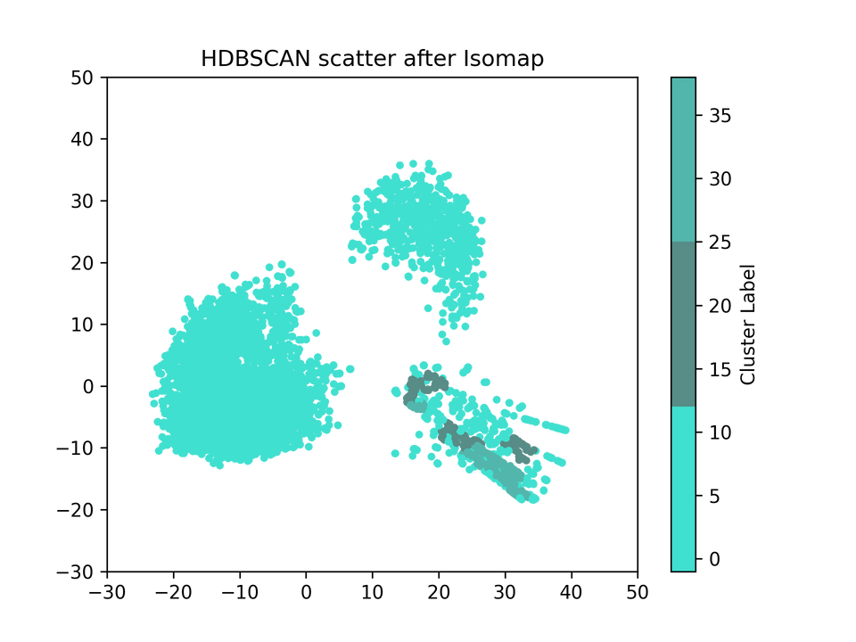
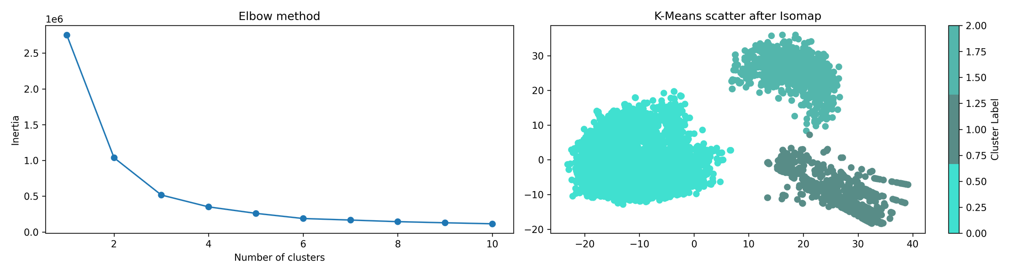
Clustering Algorithm
Step 4:
Clustering our data:
K-means
HDBSCAN

Slide 8


Clusters
0
1
2
Using both telephone and Internet services
Mostly have no dependent
Mostly have month-to-month contract, paperless billing and paying with electronic check
Median monthly charge is 80$
33% chance of churn
Using telephone but no Internet service
Mostly have 1 line
Mostly under 65 years old
Paying less than 30$ monthly, mostly via mailed check
Less than 10% chance of churn
Using DSL Internet service only, no telephone service
Paying between 0 and 80$ monthly, with the majority of customers paying between 30$ and 50$.
About 25% chance of churn

Slide 9
Tableau dashboard

Slide 10


Recommendations
Churn prevention:
All clusters: Retain sernior citizens with personalised offers.
Cluster 0: Retain customers with specific offers on additional internet service when using Fiber Optic, especially Online Backup and Device Protection. Intensify these offers in the first year of subscription.
Cluster 2: Run special offer on Tech Support.
Loyalty program
Cluster 1: Reward customers to maintain engagement.
Upselling
All clusters: Run incentive to subscribe to multiple telephone lines.
Cluster 1: Offer service upgrades, such as internet services.

Slide 11
Improvements
Additional measures like satisfaction score, customer lifetime value, or subscriptions’ prices
Information on competitors
Machine learning

Slide 12

Telco Company
Thank You!
Lucie Stenger
Ironhack Bootcamp
October 2024

